Slide 1
Word Embedding Based Multi-Layer Perceptron Prediction for Biological Event Trigger Identification
· · ·
Supervisor : Wenge Rong
Reporter： Nan Jiang
School of Computer Science & Engineering

Slide 2
· · ·
Contents
Introduction
Architecture
Experiment

Slide 3
Introduction
1

Slide 4
·
1
Introduction
Biological Event
Exploit structural information for enormous Biomedical Corpus for human inspection
Composion:
Biological term identification;
Event trigger identification;
Event argument detection.

Slide 5
·
1
Introduction
Historical Method
Regular Expression & Pattern Templates;
Traditional Machine Learning Method;
Deep learning with word embedding.

Slide 6
·
1
Introduction
Our Work
Cause:
Event trigger identification contribute 60% of event extraction error
Contribution:
We alter BOW feature to semantic word embedding feature.
We use better MLP neural networks to improve classification.

Slide 7
2
Architecture

Slide 8
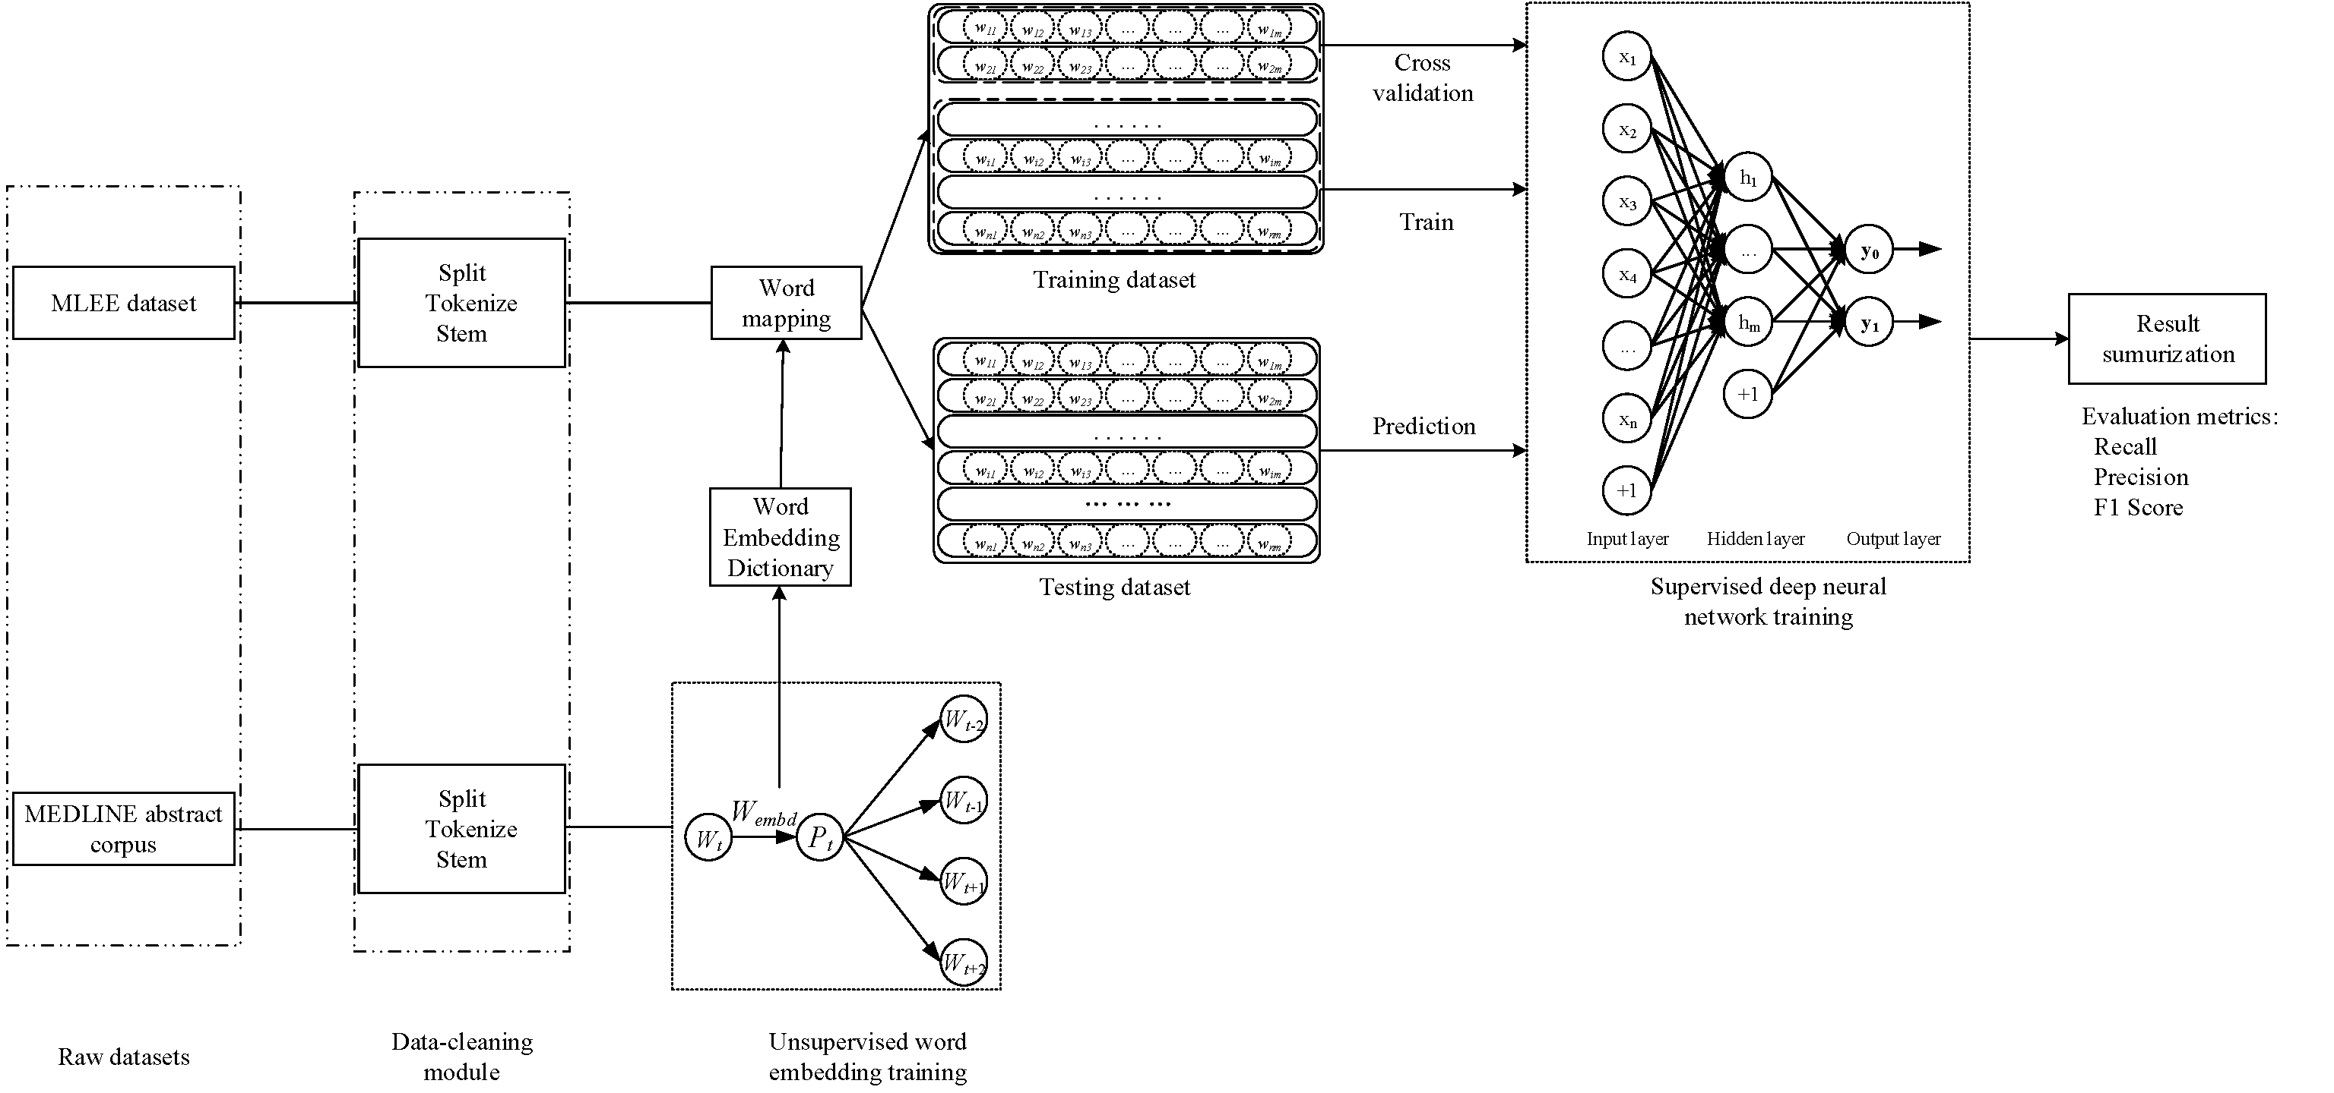
·
2
Architecture
Pipeline
Unsupervised word embedding extraction；
Supervised multi-layer perceptron prediction；

Slide 9
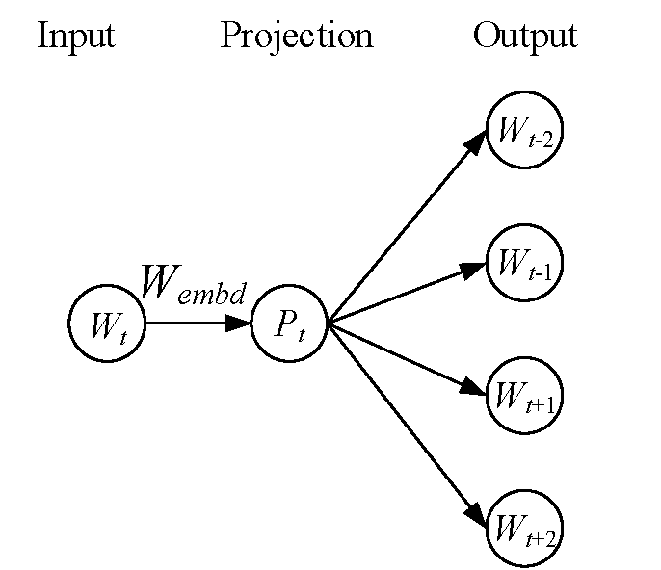
·
2
Architecture
Word embedding
Input large biological publications texts;
Skip-gram model training;
Get word embedding Dictionary
D_{embd} for each word;

Slide 10
·
2
Architecture
MLP classification
Divide multi-classes into one-versus-the-rest classification;
Map word into word-embedding feature;
Train 3-layer model and make prediction;
Calculate the evaluation metrics.

Slide 11

·
2
Architecture
稀疏惩罚因子
KL因子:
L1范数:
L2范数:
Student-t因子:
$$h\left(x\right)=f\left(Wx+b\right)$$

Slide 12
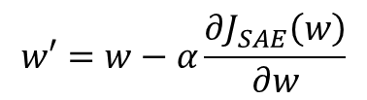
·
2
Architecture
模型训练
$$w′=w−α\frac{∂J_{SAE}\left(w\right)}{∂w}$$
迭代更新权重矩阵：
实验中采用优化后的变形方法 L-BFGS 算法

Slide 13
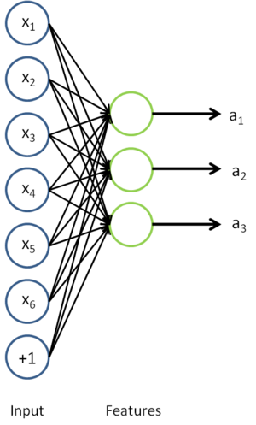

·
2
Architecture
Softmax分类算法
是一种对二元分类算法的拓展，用于多标签分类
基于贝叶斯概率模型，选择概率最大的表签
$$h_{θ}(x^{\left(i\right)})=\left[\begin{matrix}\left.p(y^{\left(i\right)}=1|x^{\left(i\right)};θ\right) \\ \left.p(y^{\left(i\right)}=2|x^{\left(i\right)};θ\right) \\ ⋮ \\ \left.p(y^{\left(i\right)}=k|x^{\left(i\right)};θ\right)\end{matrix}\right]$$

Slide 14
·
2
Architecture
评价指标
特征稀疏度：
重构误差：
正确率：

Slide 15
3
Experiment

Slide 16
·
3
Experiment
Dataset
MLEE dataset：
train : validation : test
PubMed dataset:
crawl biological publications abstract
Cleaning Method:
Splitting; Tokenize; Stemming;

Slide 17
·
3
Experiment
Baselines
Pyysalo et al;
Zhou et al;
Nie et al;

Slide 18
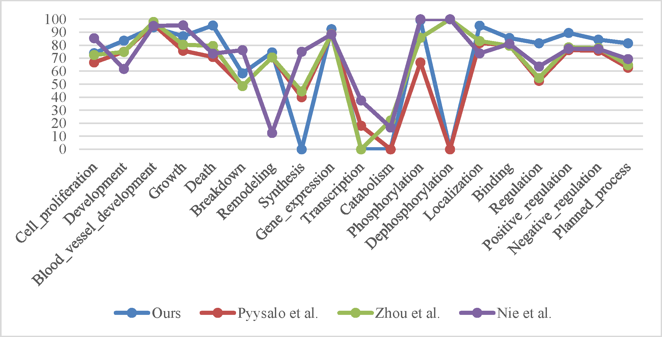
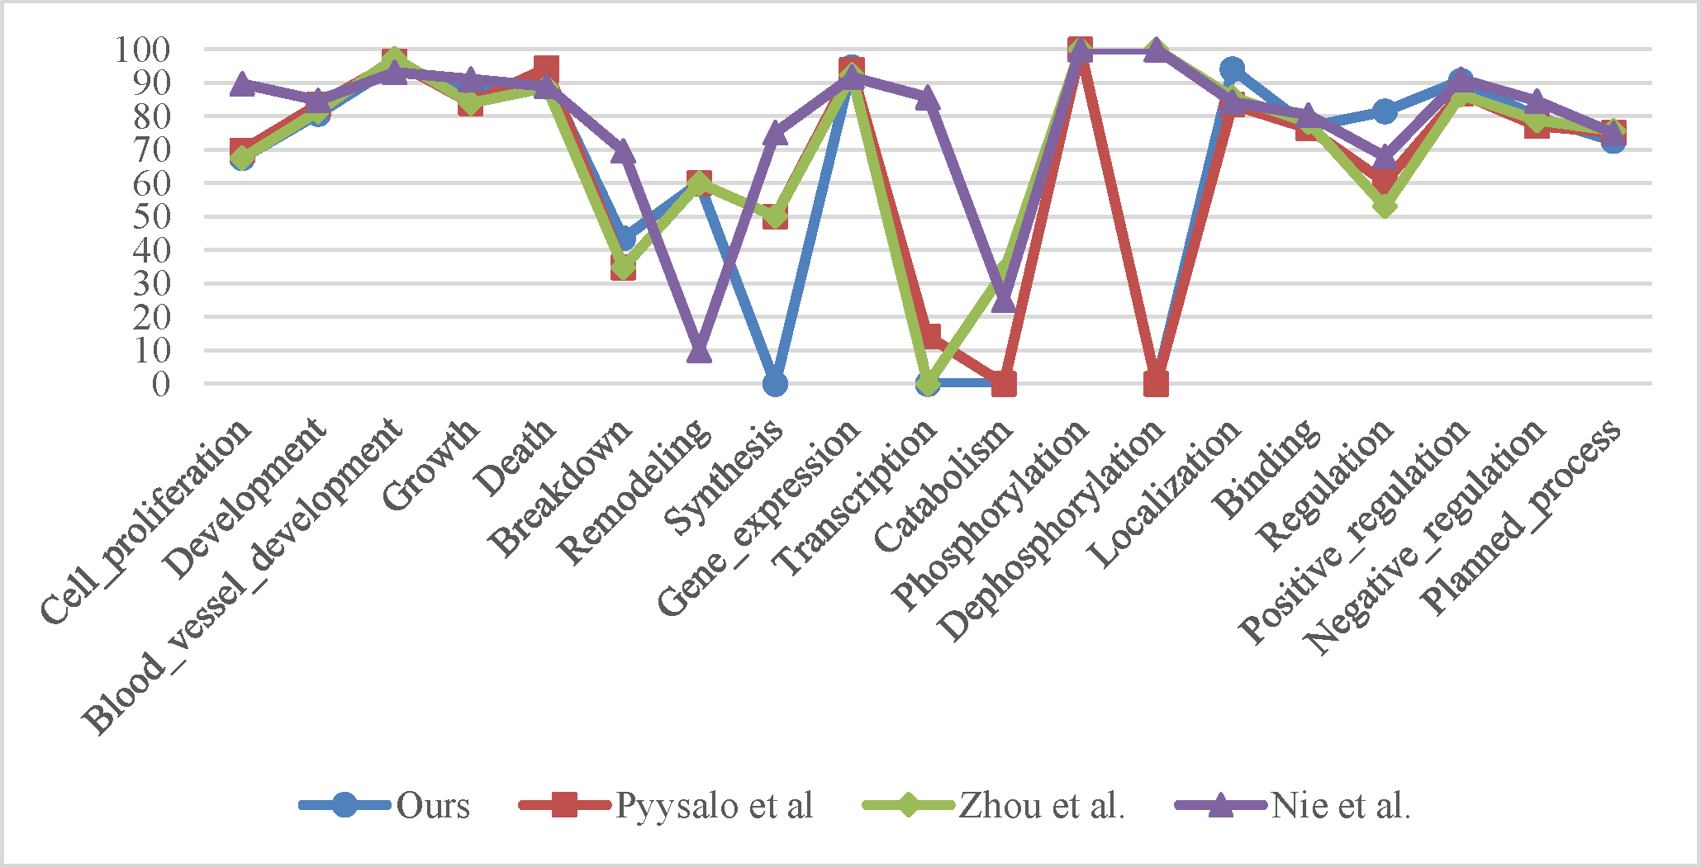
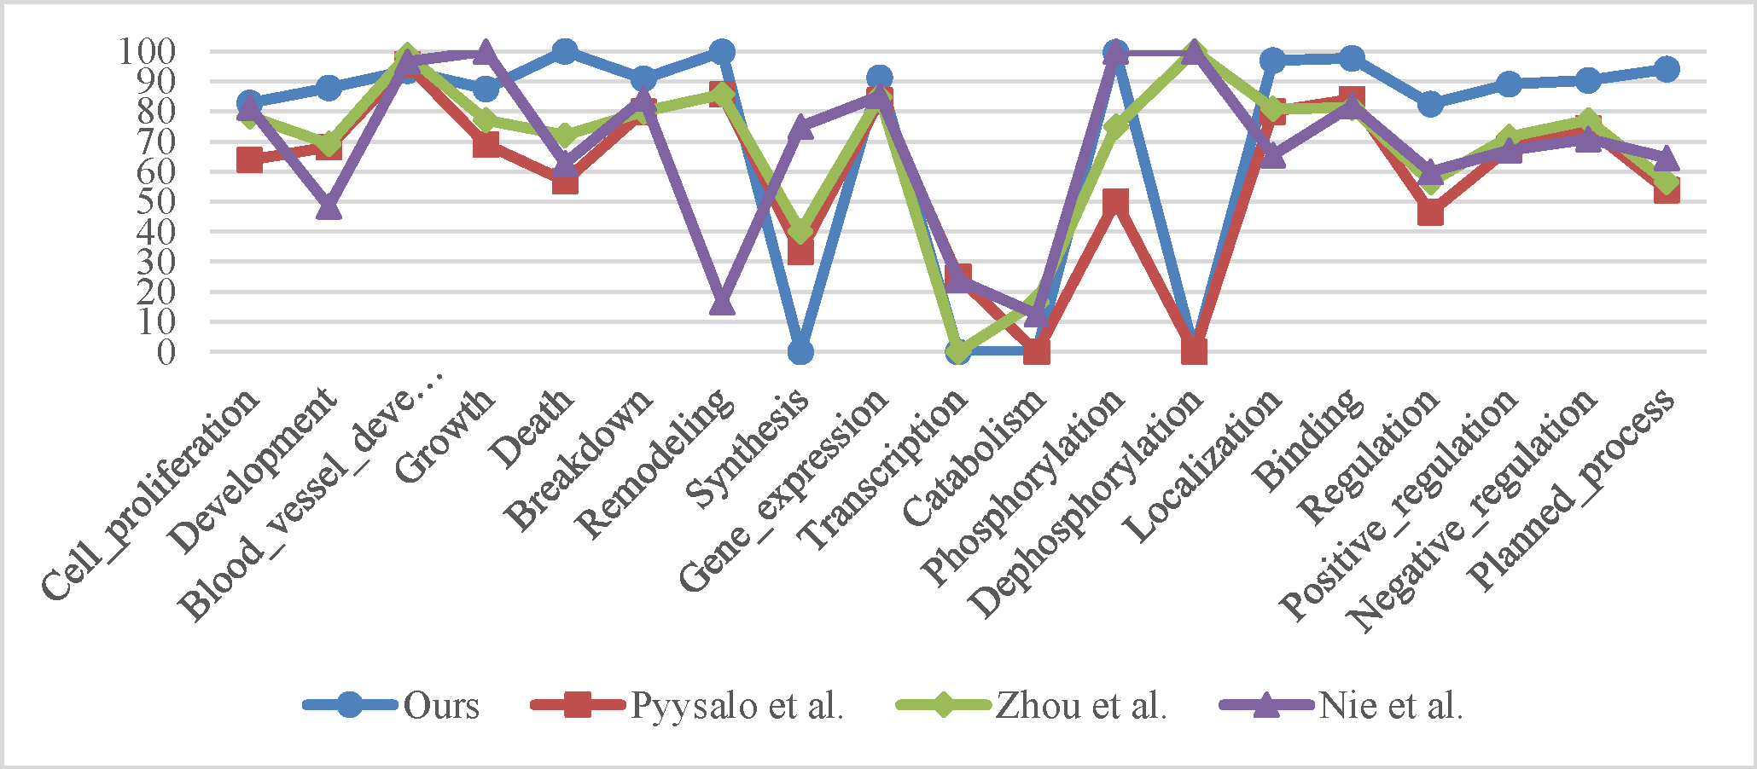
·
3
Experiment
Results

Slide 19
·
3
Experiment
Overall Results
Overall Experiment Result of Event Types
Methods | Recall(%) | Precision(%) | F1 score(%)
Ours | 84.74 | 90.76 | 87.65
Nie et al. | 84.62 | 73.3 | 78.56
Zhou et al. | 81.6 | 75.35 | 78.35
Pyysalo et al. | 82.04 | 70.75 | 75.98

Slide 20
4
Conclusion

Slide 21
·
4
Conclusion
Main work
Build skip-gram model for word embedding & MLP model for classification
Verify pipeline on MLEE dataset with baselines
Achieve state-of-the-art results in our evaluation metrics.

Slide 22
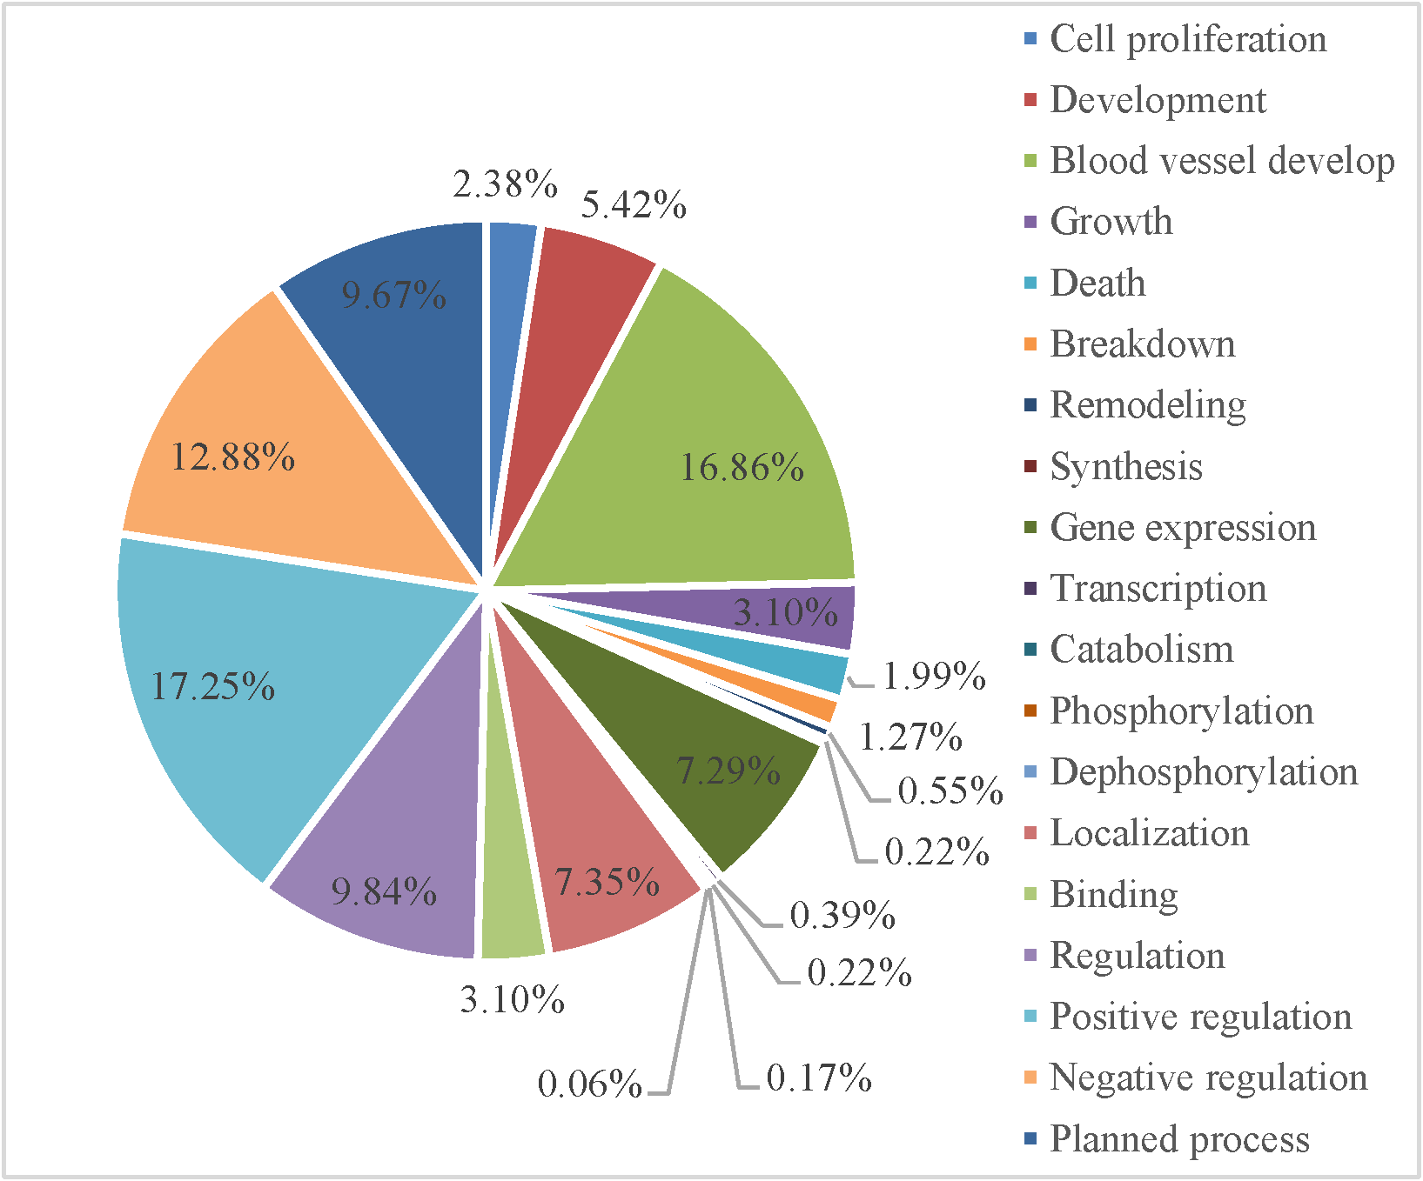
·
4
Conclusion
Drawback
Skew dataset
More dataset validation
Better word embedding model.

Slide 23
Thank You!

